Slide 1
Personal Finance
Yusuf Kadi

Slide 2
Energizer

Slide 3
Learning Objectives
Identify the components of the five step financial planning process.
Utilize the SMART goal process when making financial decisions.
Identify the purpose of a budget and how to implement it into your life.
Describe reasons for saving and investing.
Recognize when and where using credit advantages you.
Inquire Phase

Slide 4
Kahoot
Inquire Phase

Slide 5
Reflection
Reflection

Slide 6
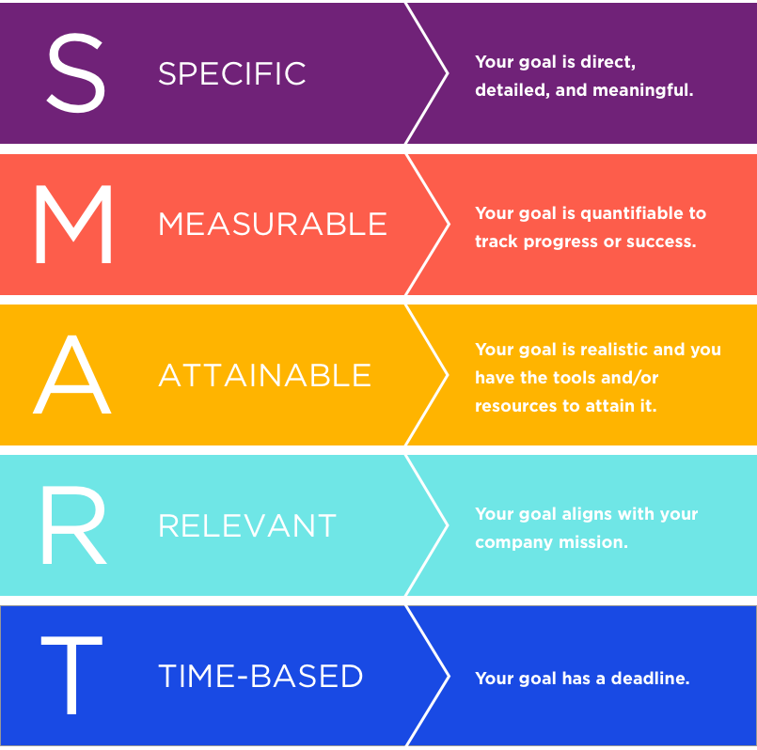
Setting Financial Goals
Gather Phase

Slide 7
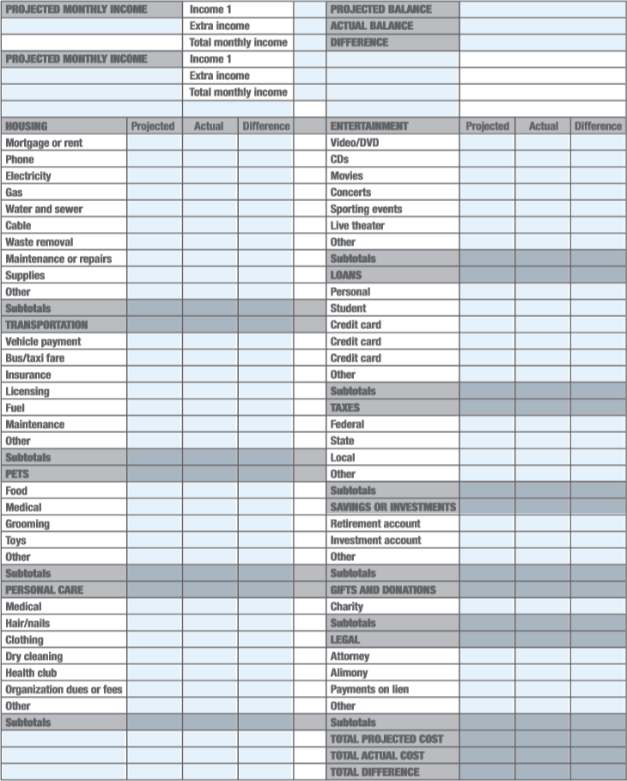
Budgeting
Needs/Wants
Delayed Gratification
Taxes
Saving & Investing
Gather Phase

Slide 8
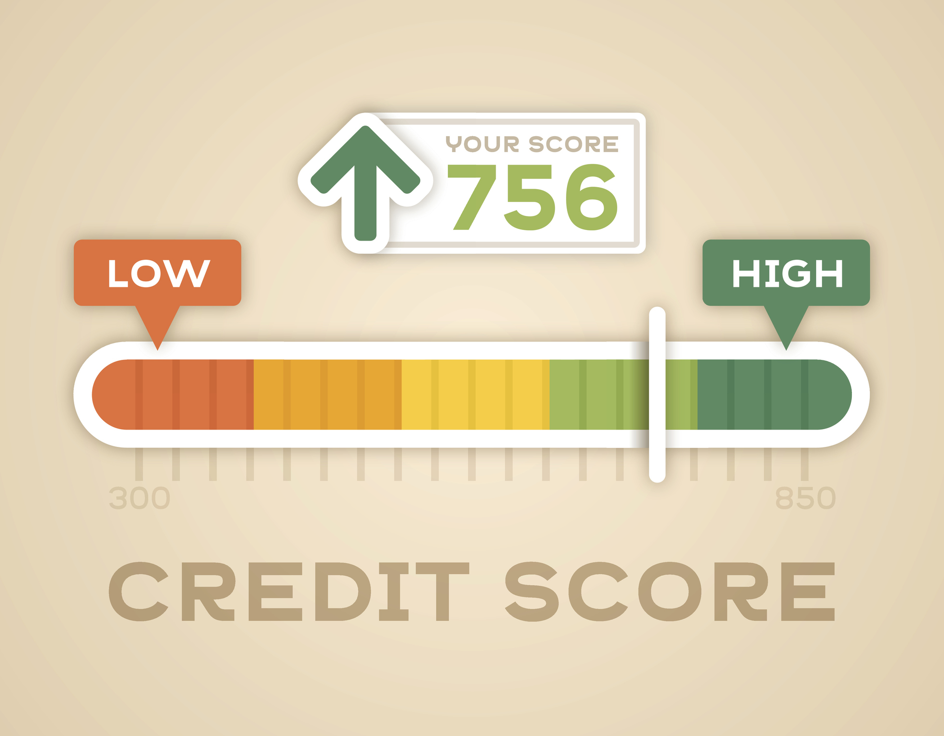
Managing Your Credit Score
Pay on TIme
Check Credit Reports
Remove Yourself From Mailing Lists
Autopay
Gather Phase

Slide 9
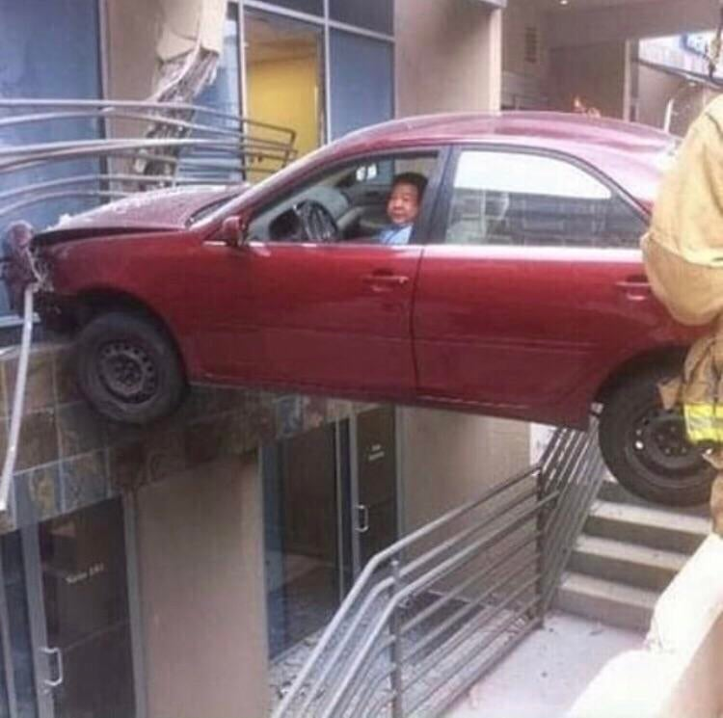
Insurance
Types of Insurance
Premium, Deductible, Copay, Coinsurance
Gather Phase

Slide 10
What is the importance of insurance?
Why is it important to have a good credit score even when you don’t need to borrow money?
Why is budgeting important?
Reflection

Slide 11
Learned Section
Process Phase

Slide 12
Share W/ Peers
Reflection

Slide 13
Practical Application
Apply Phase

Slide 14
Learning Objectives
Identify the components of the five step financial planning process.
Utilize the SMART goal process when making financial decisions.
Identify the purpose of a budget and how to implement it into your life.
Describe reasons for saving and investing.
Recognize when and where using credit advantages you.
Reflection & Closing Statement

